Slide 1
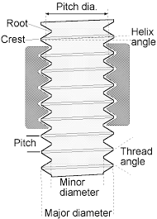
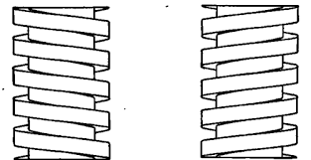
Theory of machines Wessam Al Azzawi
Friction:
Screw Friction
  Screws and nuts used for temporary fastenings
  Made by cutting a helical groove on a cylindrical surface.
  If thread is on the outer surface, external thread
  If thread is on the inner surface, internal thread
  Threads are two types V-threads and square threads
  V-threads are stronger and more frictional resistance
  V-threads have an advantage of preventing the nut from slackening
  V-threads are used for the purpose of tightening pieces together
  Square threads are used in screw jacks, vice screws

Slide 2
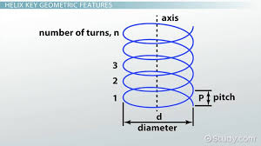
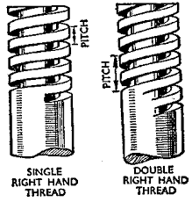

Theory of machines Wessam Al Azzawi
Friction:
following terms are important for the study of screw :
      Helix. is the curve formed by a particle moving along a screw thread
      Pitch. is the distance from a point to corresponding point on the thread parallel to the screw axis
      Lead. is the distance, a screw advances axially in one turn.
      Depth of thread. It is the distance between the top and bottom of a thread
      Single-threaded screw. If the lead of a screw is equal to its pitch, it is known as single threaded screw.
      Multi-threaded screw. If more than one thread is cut in one lead distance of a screw, it is known as multi-threaded screw e.g. in a double threaded screw
      Lead = Pitch × Number of threads
      Helix angle. It is the slope or inclination of the thread with the horizontal
= p/πd ……..(In single-threaded screw)
= n.p/πd ……..(In multi-threaded screw)

Slide 3
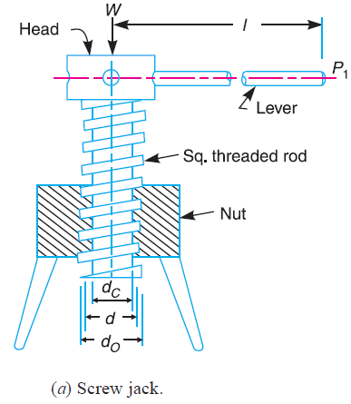
Theory of machines Wessam Al Azzawi
Friction:
Screw jack:
      is a device for lifting heavy loads by applying smaller effort. It uses the principle of inclined plane
      It consists of a square threaded rod called screw
      It fits into the inner threads of the nut.
      The load is placed on the head of the square threaded rod

Slide 4
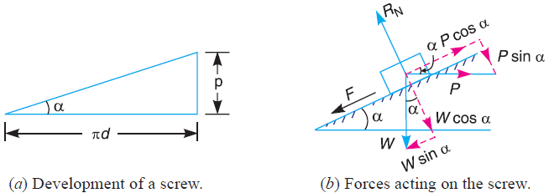
Theory of machines Wessam Al Azzawi
Friction:
      Torque Required to Lift the Load by a Screw Jack:
      p = Pitch
      d = Mean diameter
      α = Helix angle
      P = Effort lift the load,
      W = Load to be lifted
      μ = Coefficient of friction
                tan α = p/π d
                Lifting load friction F = μ.R_{N} is downward
                Resolving the forces along the plane
                P cos α = W sin α + F = W sin α + μ.RN ……………………………….(i)
                Resolving perpendicular to the plane
                R_{N} = P sin α + W cos α ……………………………………………………...(ii)
                Substituting this value of R_{N} in equation (i)
                P cos α = W sin α + μ (P sin α + W cos α)
                = W sin α + μ P sin α + μ W cos α

Slide 5



Theory of machines Wessam Al Azzawi
Friction:
Put μ = tan φ
P= W tan (α + φ)
∴ Torque required
If the axial load is taken up by a thrust collar or a flat surface, as shown in Fig., the torque required to overcome friction at the collar
Total torque:
If an effort P₁ is applied at the end of a lever of arm length l, then the total torque required

Slide 6
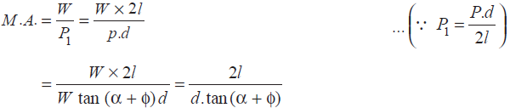
Theory of machines Wessam Al Azzawi
Friction:
the nominal diameter (d₀) and the **core diameter (d_{c}) of the screw thread is given
Since the mechanical advantage is the ratio of load lifted (W) to the effort applied (P₁) at the end of the lever,

Slide 7
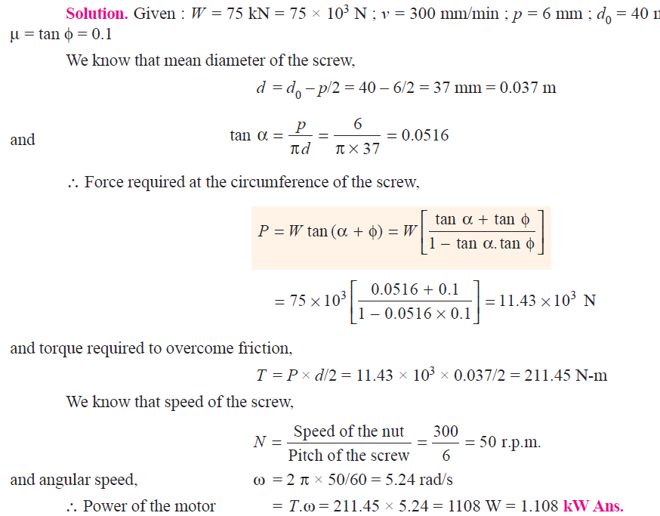
Theory of machines Wessam Al Azzawi
Friction:
Example. An electric motor driven power screw moves a nut in a horizontal plane against a force of 75 kN at a speed of 300 mm/min. The screw has a single square thread of 6 mm pitch on a major diameter (nominal diameter) of 40 mm. The coefficient of friction at the screw threads is 0.1. Estimate power of the motor.

Slide 8
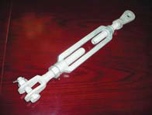
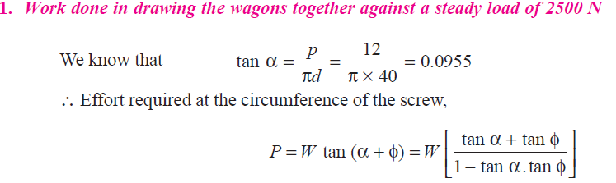
Theory of machines Wessam Al Azzawi
Friction:
Example. A turnbuckle, with right and left hand single start threads, is used to couple
two wagons. Its thread pitch is 12 mm and mean diameter 40 mm. The coefficient of friction between the nut and screw is 0.16. 1. Determine the work done in drawing the
wagons together a distance of 240 mm, against a steady load of 2500 N. 2. If the load increases from 2500 N to 6000 N over the distance of 240mm, what is the work to be done?
Solution. Given : p = 12 mm ; d = 40 mm ; μ = tan φ = 0.16 ;
W = 2500 N

Slide 9
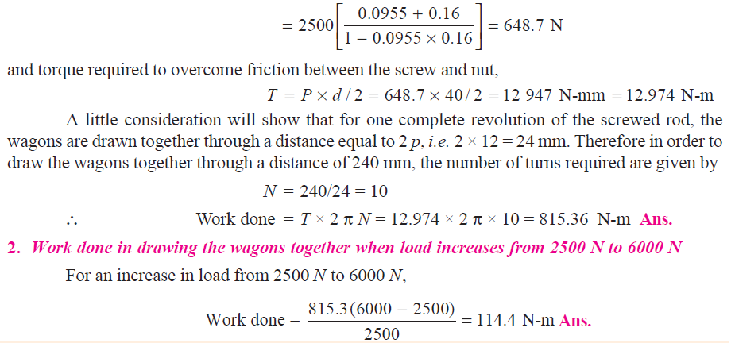
Theory of machines Wessam Al Azzawi

Slide 10
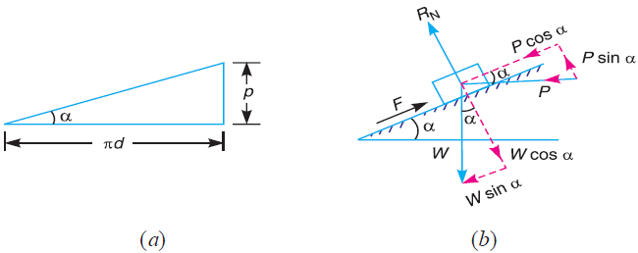

Theory of machines Wessam Al Azzawi
Friction:
      Torque Required to Lower the Load by a Screw Jack:
      p = Pitch
      d = Mean diameter
      α = Helix angle
      P = Effort lower the load
      W = Weight to be lowered
      μ = Coefficient of friction
                tan α = p/π d
                Lifting load friction F = μ.R_{N} is upward
                Resolving the forces along the plane
                P cos α = F -W sin α = μ.R_{N} -W sin α ……….………………………….(i)
                Resolving perpendicular to the plane
                R_{N} = W cos α- P sin α ……………..………………………………………...(ii)
                Substituting this value of R_{N} in equation (i)
                P= W tan (φ − α)
                ∴ Torque required to overcome friction between the screw and nut,
                When α > φ, then P = tan (α – φ)

Slide 11
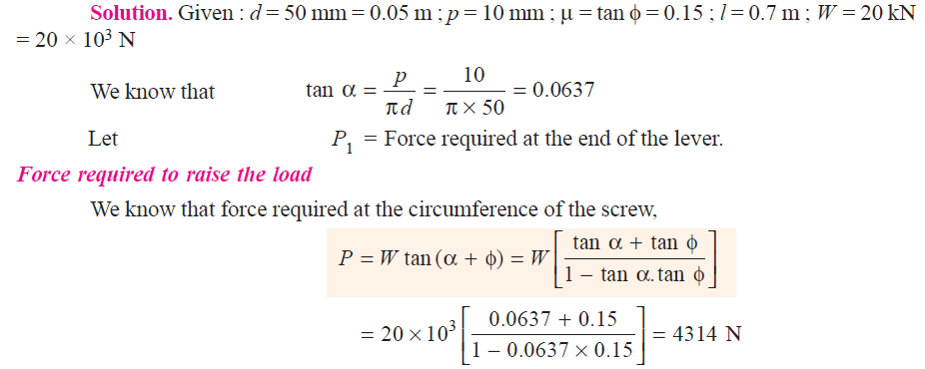
Theory of machines Wessam Al Azzawi
Friction:
Example. The mean diameter of a square threaded screw jack is 50 mm. The pitch of the thread is 10 mm. The coefficient of friction is 0.15. What force must be applied at the end of a 0.7 m long lever, which is perpendicular to the longitudinal axis of the screw to raise a load of 20 kN and to lower it?

Slide 12
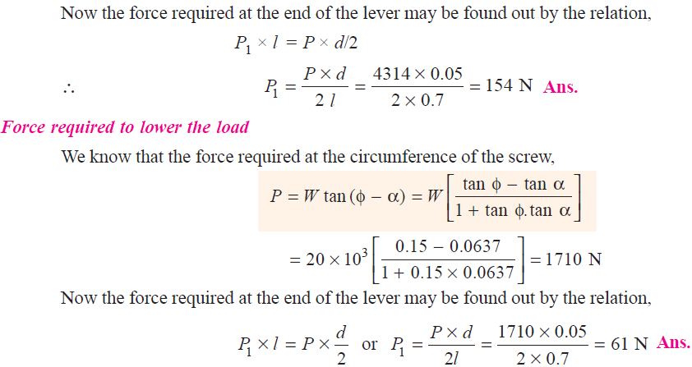
Theory of machines Wessam Al Azzawi

Slide 13
Theory of machines Wessam Al Azzawi
Friction:
      Efficiency of a Screw Jack a Screw Jack:
      Efficiency of a screw jack may be defined as the ratio between effort required neglecting friction to the effort required when friction is taken into account.
      For no friction, φ equal to zero
      P₀ = W tan α
      Efficiency is independent of the load raised

Slide 14
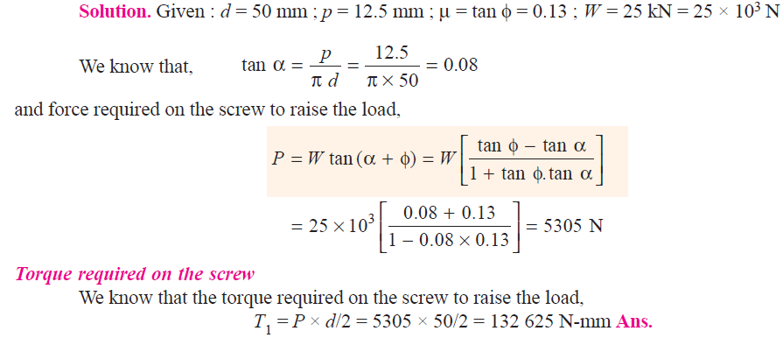
Theory of machines Wessam Al Azzawi
Friction:
Example. The pitch of 50 mm mean diameter threaded screw of a screw jack is 12.5 mm. The coefficient of friction between the screw and the nut is 0.13. Determine the torque required on the screw to raise a load of 25 kN, assuming the load to rotate with the screw. Determine the ratio of the torque required to raise the load to the torque required to lower the load and also the efficiency of the machine.

Slide 15
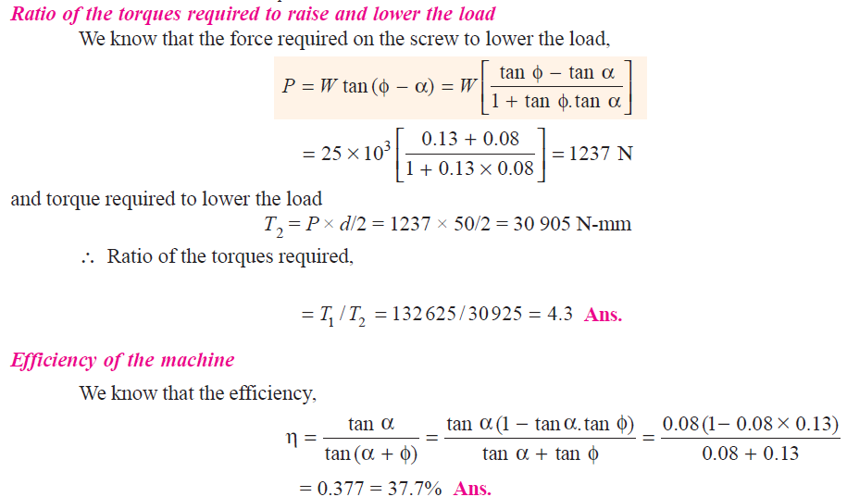
Theory of machines Wessam Al Azzawi

Slide 16
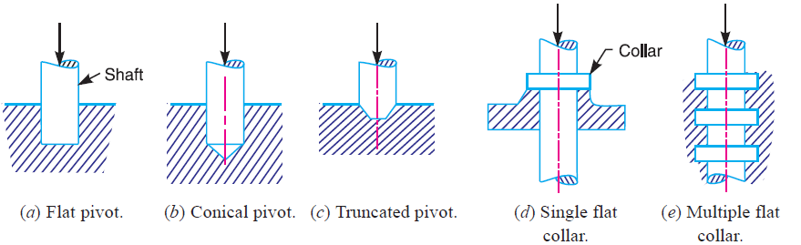
Theory of machines Wessam Al Azzawi
Friction:
Friction of Pivot and Collar Bearing:
      Pivot and collar bearings are used to take the axial thrust of the rotating shaft
      Pivot may have a flat surface or conical surface

Slide 17
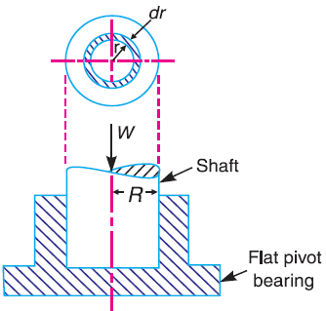
Theory of machines Wessam Al Azzawi
Friction:
Friction of Pivot and Collar Bearing:
      Flat Pivot Bearing
      W =Load transmitted
      R =Radius of bearing surface,
      p =Intensity of pressure per unit area of bearing
      μ =Coefficient of friction.
      We will consider a uniform pressure case

Slide 18

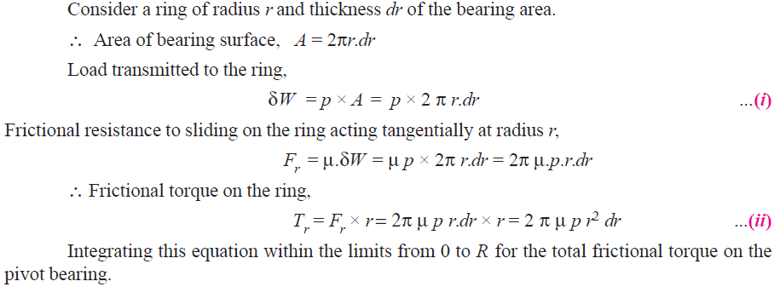
Theory of machines Wessam Al Azzawi
Friction:
      Pressure is uniformly distributed

Slide 19
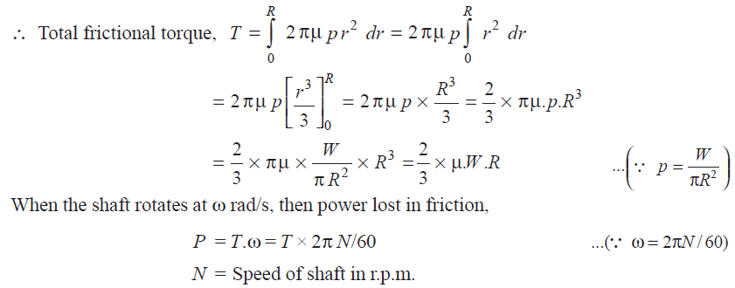
Theory of machines Wessam Al Azzawi
Friction:

Slide 20
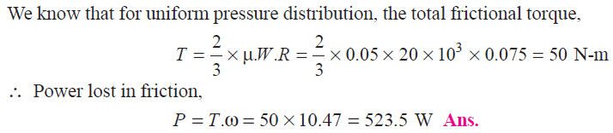
Theory of machines Wessam Al Azzawi
Friction:
      Example. A vertical shaft 150 mm in diameter rotating at 100 r.p.m. rests on a flat end footstep bearing. The shaft carries a vertical load of 20 kN. Assuming uniform pressure distribution and coefficient of friction equal to 0.05, estimate power lost in friction.

Slide 21
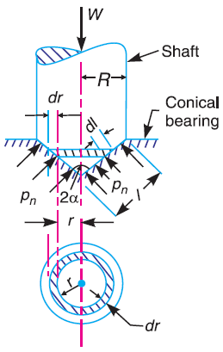
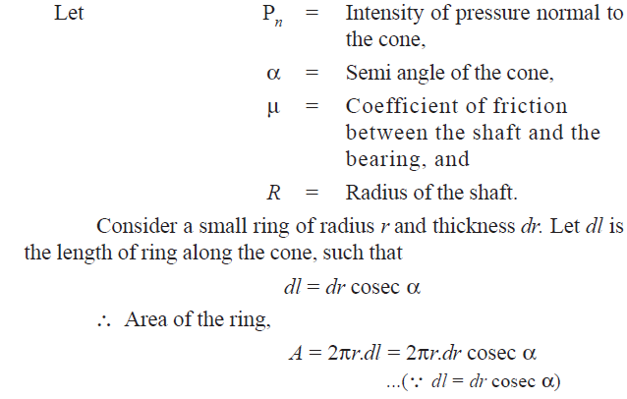
Theory of machines Wessam Al Azzawi
Friction:
      Conical Pivot Bearing

Slide 22
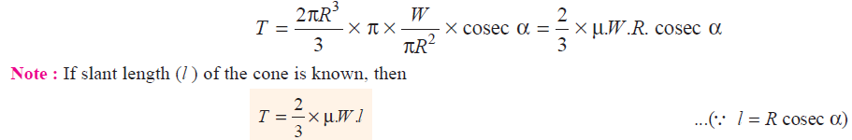
Theory of machines Wessam Al Azzawi
Friction:
      Conical Pivot Bearing

Slide 23
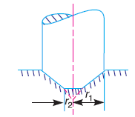
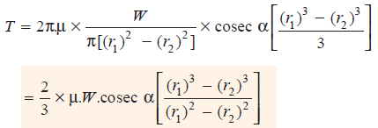
Theory of machines Wessam Al Azzawi
Friction:
      Trapezoidal Conical Pivot Bearing

Slide 24
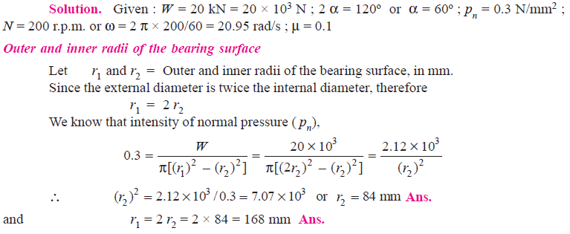
Theory of machines Wessam Al Azzawi
Friction:
      Example. A conical pivot supports a load of 20 kN, the cone angle is 120º and the intensity of normal pressure is not to exceed 0.3 N/mm2. The external diameter is twice the internal diameter. Find the outer and inner radii of the bearing surface. If the shaft rotates at 200 r.p.m. and the coefficient of friction is 0.1, find the power absorbed in friction. Assume uniform pressure.

Slide 25
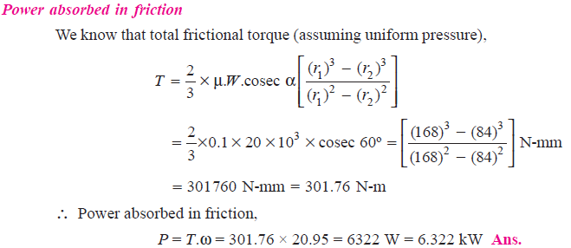
Theory of machines Wessam Al Azzawi
Friction:

